Slide 1
© fantastic teacher2020
Mrs. Abbott ~ Kindergarten
ATTENDANCE
ABOUT ME
WELCOME TO
MEET THE
TEACHER NIGHT
BIRTHDAYS
STUDENTS
ARRIVAL
SPECIAL EVENTS
SCHEDULE
CURRICULUM
RULES
ASSIGNMENTS/
GRADING
SUPPLIES
CONTACT ME

Slide 2
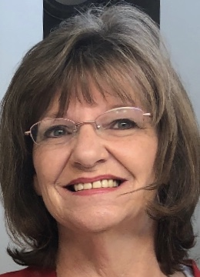
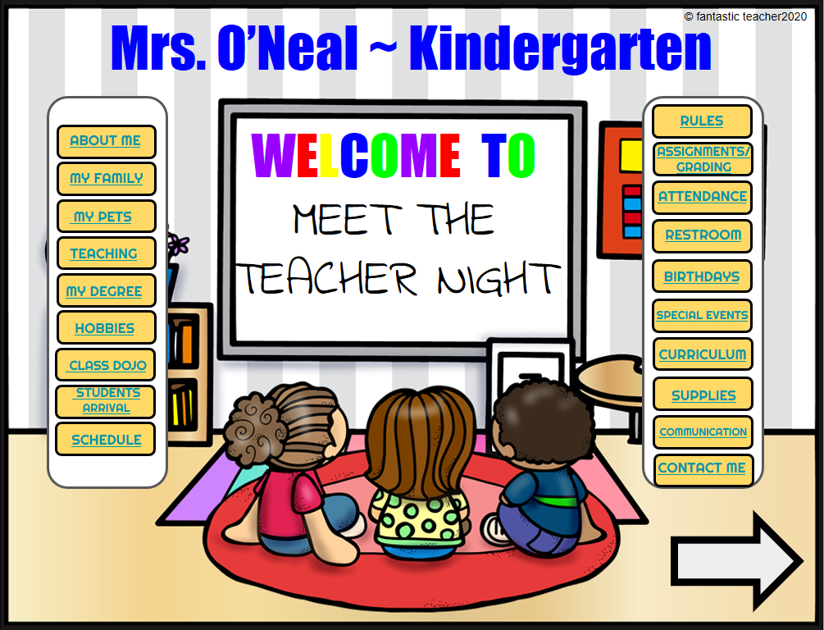
© fantastic teacher2020
ALL ABOUT ME
My name is Janet Abbott, this is my 28th year teaching. This will be my 20th year in Kindergarten! I have a Master’s Degree in Educational Administration, from Coastal Carolina University. I also have a Master’s Degree in Special Education from Eastern Kentucky University. I received my Bachelor's Degree in Early Childhood from Lincoln Memorial University, in Tennessee.

Slide 3
STUDENTS ARRIVAL PROCEDURES
Virtual school starts promptly at 8:00am.
Be on time.
Wear appropriate clothing (no pajamas).
Have your video on so we can see your wonderful face!
© fantastic teacher2020

Slide 4
VIRTUAL SCHEDULE
Time | Monday | Tuesday | Wednesday | Thursday | Friday
8:00 -8:20 am | Morning Meeting/SEL | Morning Meeting/SEL | Morning Meeting/SEL | Morning Meeting/SEL | Morning Meeting/SEL
8:20 – 8:35 am | Read Aloud | Read Aloud | Read Aloud | Read Aloud | Read Aloud
8:35 – 9:00 am | Shared Reading/Mini Lesson | Shared Reading/Mini Lesson | Shared Reading/Mini Lesson | Shared Reading/Mini Lesson | Shared Reading/Mini Lesson
9:00 – 10:00 am | Guided Reading/Indep Practice/Break as needed | Guided Reading/Indep Practice/Break as needed | Guided Reading/Indep Practice/Break as needed | Guided Reading/Indep Practice/Break as needed | Guided Reading/Indep Practice/Break as needed
10:00 – 10:20 am | Word Work | Writing | Word Work | Writing | Word Work
10:20 – 11:00 am | Lunch & Recess | Lunch & Recess | Lunch & Recess | Lunch & Recess | Lunch & Recess
11:00 – 11:10 am | Math Fluency | Math Fluency | Math Fluency | Math Fluency | Math Fluency
11:10 -11:25 am | Math Application | Math Application | Math Application | Math Application | Math Application
11:25 – 12:00 pm | Lesson (Concept Development) | Lesson (Concept Development) | Lesson (Concept Development) | Lesson (Concept Development) | Lesson (Concept Development)
12:00 -12:30 pm | Guided/Indep. Practice | Guided/Indep. Practice | Guided/Indep. Practice | Guided/Indep. Practice | Guided/Indep. Practice
12:30 – 12:45 | Break | Break | Break | Break | Break
12:45 – 1:15 pm | Science/Social Studies * | Science/Social Studies * | Science/Social Studies * | Science/Social Studies * | Science/Social Studies *
1:15 – 1:55 pm | Special Area PE | Special Area Art *Provided art teacher is replaced. If not, it will be a P.E. lesson. | Special Area Music | Special Area Guidance | Special Area Library
© fantastic teacher2020

Slide 5
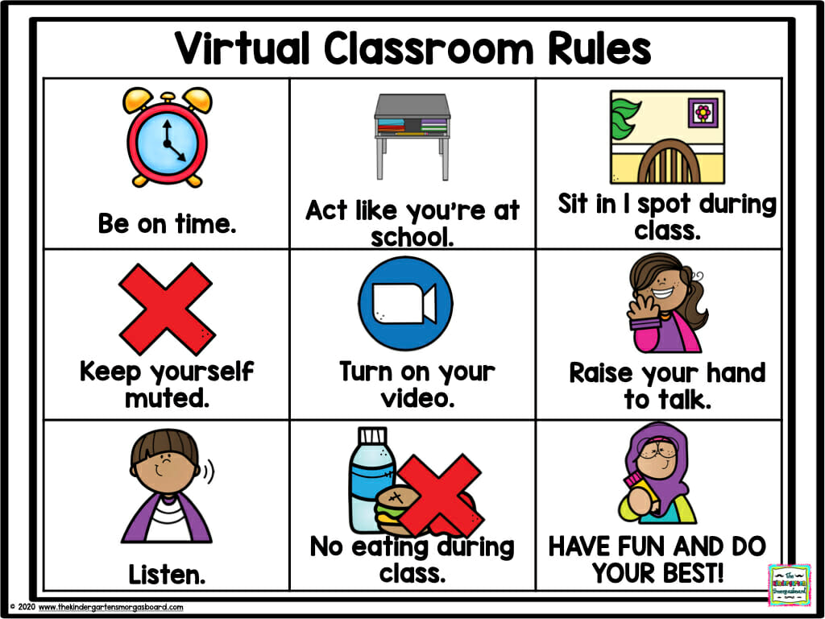
OUR CLASSROOM RULES
© fantastic teacher2020

Slide 6
ASSIGNMENTS/GRADING
Turn assignments in on time!
This is one of the ways we take attendence.
The grading system will remain on the four-point scale that it is currently used in a traditional school setting.
E- Consistently exceeds grade level expectations.
M- Meets grade level expectations.
P- Progressing towards, but still not meeting grade level standards.
N- Not meeting grade level expectations at this time.
© fantastic teacher2020

Slide 7
ATTENDANCE
Attending and participating in LIVE lessons
Turning in assignments on time
Participating in recorded lessons
Completing curriculum
© fantastic teacher2020

Slide 8
BIRTHDAYS
We will be celebrating birthdays in the mornings during our Morning Meeting.
Birthday song
Birthday student “show and tell”
Other students take turns saying something special to the birthday student or about the birthday student
© fantastic teacher2020

Slide 9
SPECIAL EVENTS
Virtual field trips
Special guests
Game days
Spirit days
Teacher drive-by
Pajama days
© fantastic teacher2020

Slide 10
CURRICULUM
Please see the district website for more information.
© fantastic teacher2020

Slide 11
SCHOOL SUPPLIES
MCSD K-12 Virtual Academy
2020-21 School Supply List
Grades K-2
*Additional requests may be made by individual teachers
Internet access
Headphones w/microphone
4 – One subject notebooks (Wide Ruled)
Loose leaf paper (Wide Ruled)
4 – Pocket folders
#2 Pencils
Scissors
Glue sticks –Elmer’s purple jumbo
Construction Paper
Copy Paper
Index Cards
1 pack of 24 Crayola Crayons
Sticky notes
Highlighters
1 pack of 12 Colored Pencils
1 pack of 8 Crayola Classic Markers
Playdough
© fantastic teacher2020

Slide 12
HOW TO CONTACT ME?
Email: jabbott@marion.k12.sc.us
Phone: 843-423-8335 Ext: 3000
© fantastic teacher2020

